Slide 1
HIPAA Implementation Guides
Down and Dirty
004010
Who needs to understand them?

Slide 2

Session Objectives
Standards support business activity
Introduce standards documentation
Introduce standards implementation guidelines
Develop sample 837 transaction set

Slide 3
NORMAL BUSINESS
ELIGIBILITY
VERIFICATION
CUST
SERVICE
ALLIANCE
DETROIT MI
SERVICE
CLAIMS
CLAIMS
PROCESSING
ALLIANCE
DETROIT MI
CUST
SERVICE
ENROLLMENT

Slide 4
PAPER vs EDI
Document
-
Transaction
Little Envelope
-
Functional Group
Big Envelope
-
Interchange
Postal Service
-
VAN
Courier Delivery
-
Point-to-Point
Human Audit
-
Machine Audit

Slide 5
EDI Delivery
270
FUNCTIONAL
GROUP
INTERCHANGE
EDI
VAN
837
FUNCTIONAL
GROUP
INTERCHANGE
834
FUNCTIONAL
GROUP

Slide 6
Standards Language
Document
-
Transaction
Line
-
Segment
Claim
Phrase
-
Composite Element
Word
-
Simple Element
Code
-
Identifier
Punctuation
-
Delimiters
Grammar
-
Syntax

Slide 7
SIMPLE AND COMPOSITE
DATA ELEMENTS
N1*PR*ABC INS CO*PI*ABC47~
TOO*JP*8*F:L~

Slide 8
Levels of Standards Documentation
ANSI X12 Standards Documentation
Industry Implementation Guidelines
Trading Partner Profiles

Slide 9
Section I - Transaction Set Tables
Table 1
ST
Header
BHT
Related information
usually appears
together.
Table 2
HL
Detail
Table 3
Summary
SE

Slide 10






837 Health Care Claim
Functional Group ID: HC
Table 1 – Header
POS# SEG ID NAME REQ. DES MAX USE LOOP REPEAT
005 ST Transaction Set Header M 1
010 BHT Beginning of Hierarchical Transaction M 1
LOOP ID – 1000 10
020 NM1 Individual or Organization Name O 1
045 PER Administration Communication Contact O 2
Table 2 – Detail
POS# SEG ID NAME REQ. DES MAX USE LOOP REPEAT
LOOP ID – 2000 >1
001 HL Hierarchical Level M 1
003 PRV Provider Information O 1
LOOP ID – 2010 10
015 NM1 Individual or Organization Name O 1
040 PER Administration Communication Contact O 2
555 SE Transaction Set Trailer M 1

Slide 11





837 Health Care Claim: Professional
Table 1 – Header
PG POS# SEG ID NAME USAGE REPEAT LOOP REPEAT
62 005 ST Transaction Set Header R 1
63 010 BHT Beginning of Hierarchical Transaction R 1
LOOP ID – 1000A SUBMITTER NAME 1
67 020 NM1 Submitter Name R 1
71 045 PER Submitter EDI Contact Information R 2
Table 2 – Detail – Billing/Pay-To Provider
PG POS# SEG ID NAME USAGE REPEAT LOOP REPEAT
LOOP ID – 2000A BILLING/PAY-TO-PROVIDER >1
77 001 HL Billing/Pay-to-Provider Hierarchical Level R 1
LOOP ID – 2010AA BILLNG PROVIDER NAME 1
84 015 NM1 Billing Provider Name R 1
Table 2 – Detail – Subscriber
573 555 SE Transaction Set Trailer R 1

Slide 12
Transaction Set Tables
Permitted segments
  Required order
    Presence requirement
      How many
        Loops

Slide 13
RECEIVER NAME
NM1 Individual or Organization Name
Level: Header
Syntax: 1. P0809
If either NM108 or NM109 is present, then the other is required.
NM101 98
Entity ID
Code
M ID 2/3
NM102 1065
Entity Type
Qualifier
M ID 1/1
NM103 1035
Name Last/
Org Name
O AN 1/35
NM104 1036
Name
First
O AN 1/25
NM1
*
*
*
*
NM105 1037
Name
Middle
O AN 1/25
NM106 1038
Name
Prefix
O AN 1/10
NM107 1039
Name
Suffix
O AN 1/10
NM108 66
ID Code
Qualifier
X ID 1/2
*
*
*
*
NM109 67
ID
CODE
X AN 2/80
NM110 706
Entity
Relat Code
X ID 2/2
NM111 98
Entity ID
Code
O ID 2/3
*
*
*
~

Slide 14
BILLING PROVIDER NAME
NM1 Individual or Organization Name
Level: Header
Syntax: 1. P0809
If either NM108 or NM109 is present, then the other is required.
NM101 98
Entity ID
Code
M ID 2/3
NM102 1065
Entity Type
Qualifier
M ID 1/1
NM103 1035
Name Last/
Org Name
O AN 1/35
NM104 1036
Name
First
O AN 1/25
NM1
*
*
*
*
NM105 1037
Name
Middle
O AN 1/25
NM106 1038
Name
Prefix
O AN 1/10
NM107 1039
Name
Suffix
O AN 1/10
NM108 66
ID Code
Qualifier
X ID 1/2
*
*
*
*
NM109 67
ID
CODE
X AN 2/80
NM110 706
Entity
Relat Code
X ID 2/2
NM111 98
Entity ID
Code
O ID 2/3
*
*
*
~

Slide 15
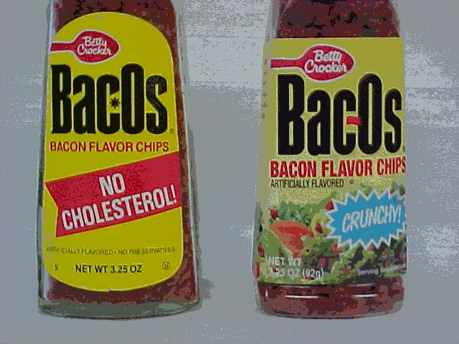

Slide 16
SEGMENT
·
An ordered collection of elements
·
Elements are variable length
·
Elements are delimited by element separators
·
Segment ends with segment terminator
~
*
*
N1

Slide 17
Data Element Dictionary
Listed numerically
Same in all segments
Data & position vary
Length min & max
Code lists
Type of data

Slide 18
HL Hierarchical Level
HL01 628
Hierarch
ID Number
M AN 1/12
HL02 734
Hierarch
Parent ID
O AN 1/12
HL03 735
Hierarch
Level Code
M ID 1/2
HL04 736
Hierarch
Child Code
O ID 1/1
HL
~
*
*
*
*
HL01 628 Hierarchical ID Number
The first HL01=1, in subsequent HL segments the value is
incremented by 1.
HL02 734 Hierarchical Parent Number
The HL02 identifies the HL01 that is the parent of this HL
segment.
HL03 735 Hierarchical Level Code
“20” = Billing Provider
“22” = Subscriber – Child to Billing Provider
“23” = Dependent – Child to Subscriber
HL04 736 Hierarchical Child Code
“0” No Subordinate HL Segment
“1” Additional Subordinate HL Data Segment

Slide 19
Hierarchical Levels in Health Care Claims
HL*1**20*1~
Billing Provider
HL*2*1*22*0~
HL*3*1*22*1~
HL*7*1*22*0~
HL*8*1*22*1~
Subscriber #1
Subscriber #2
Subscriber #3
Subscriber #4
Claim Information
Claim Information
Claim Information
Service Lines
Service Lines
Service Lines
HL*4*3*23*0~
HL*5*3*23*0~
HL*6*3*23*0~
HL*9*8*23*0~
Dependent #1
Dependent #2
Dependent #3
Dependent #1
Claim Information
Claim Information
Claim Information
Claim Information
Service Lines
Service Lines
Service Lines
Service Lines

Slide 20
Valid Element Types
AN - Alphanumeric
B - Binary
Nn - Numeric (n decimals)
R - Decimal (explicit)
ID - Code
DT - Date
TM - Time

Slide 21
AN 6/6
-
Exactly 6 characters long
R 7/10
-
From 7 to 10 digits long
LENGTH
Sign & decimal are not counted in length.

Slide 22
QUALIFIER & VALUE
·
Pairs elements (qualifier & value)
·
Flexible transaction definitions
·
Reuse elements
Reese
Sally Peterson
CHIEF FINANCIAL OFFICER
Reese Supply Company
Phone
(513) 725-7543
PO Box 1432
Fax
(513) 725-9876
Miamitown OH 45432-1432
sally@ohio.net

Slide 23
STANDARDS EVOLVE
001000
ANSI - 1983
·
Working papers
002000
ANSI - 1986
002040
Draft X12 May 89
·
Three times a year
003000
ANSI - 1992
·
Draft standards
003020
Draft X12 Oct 91
·
ANSI standards
003021
Draft X12 Feb 92
·
Version & release
004000
ANSI - 1997
004010
Draft X12 Oct 97

Slide 24
CHANGES
INVOICE
·
Simplify data.
·
Eliminate transactions.
·
Utilize status information rather than batch data.
·
Reengineer business processes.
·
Exchange information more frequently.

Slide 25
Session Summary
Standards are based on business requirements.
There are multiple details to coordinate.
One person should not make all decisions.
The business process will change over time.

